Slide 1

Named Entities Extraction from
Unstructured Business Documents
Graduation project
Fulfilled by : Eya BAKLOUTI
Professional Supervisor : Mr Amir KRIFA
Academic Supervisor : Mr Chiheb REBAI
Academic Year: 2020-2021
1
Notes:
Good Morning ,
Dear jury and supervisor thank you for your attendance ,my name is Eya Baklouti and I’m here today to present my graduation project which entitled “Named Entities Extraction from Unstructured Business Documents”.
It was realized in EY with the supervision of Mr Amir Krifa and my academic supervisor Mr chiheb rebai

Slide 2
Agenda
INSTRUCTIONS:
To change fonts from EY Interstate to Arial and vice versa
> On the “Home” tab, in the group of buttons labelled “Editing,” click the drop-down arrow in the button labelled “Replace” and choose “Replace Fonts.”
> Chose the font that you would like to replace and specify which font you’d like to appear in its place.
> Click Replace.
> It may take some time for the process to complete, depending on how much text you have in your presentation.
1. | Project Scope and Organisation
2. | Data Collection & Preparation
3. | Building a NER Model
4. | End-to-end Solution
5. | Conclusion & Perspectives
Notes:
Here is the presentation Agenda :
We are going to start with the project scope and organisation
Then moving to more details about the project realization strating with data collection & preparation
Next explaining the NER model Building
After that we are going to present the end-to-end solution
and
Finally i’m going to wrap the presentation with a conclusion and perspectives

Slide 3
1
Project Context
Hosting Company
Project Organisation & Planning
Project Scope and Organisation
3
Notes:
The project Scope and organization section is divided into 3 subsections :

Slide 4
Project Context
E-mails
Huge amount
PDFs
Scanned documents
Business Documents
Rapid increase
Unstructured
Expected to exceed 175 zettabytes By 20251
1Source : International Data Corporation (IDC) is the premier global provider of market intelligence, advisory services, and events for the information technology,
Notes:
Businesses in all domains have rich and valuable information stored as text whether in E-mails, PDFs, or scanned documents.
Most of them are unstructured
There is a huge amount of those documents.
And they are rapidly increasing
It’s expected to exceed 175 zettabytes By 2025
All of this makes extracting the necessary information from those documents a real challenge for companies.

Slide 5
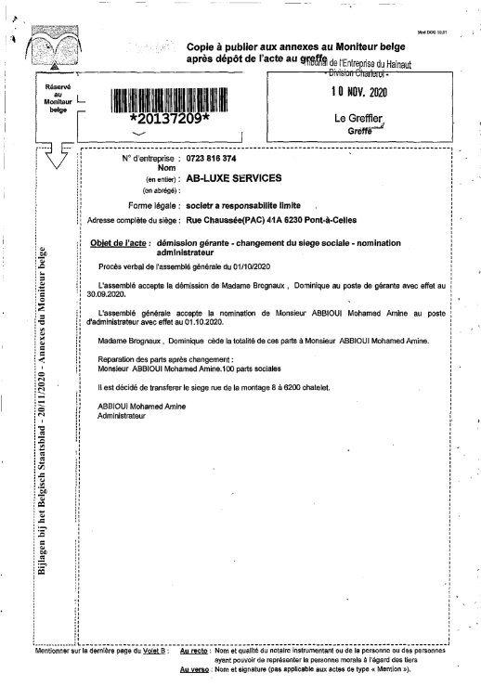
Project Context
Company bylaws: are documents in which we find the rules that govern how a company is run
Banks and insurance companies have to process their client’s bylaws
Manual processing is time consuming and inefficient
Building an AI tool that can process bylaws documents
Company name
Legal reprentative last name
Legal reprentative first name
Function
Notes:
a lot of those documents are Company bylaws ,
they are documents in which we find the rules that govern how a company is run,
Banks and insurance companies must process their client’s company bylaw either for new client onboarding or to keep existing client data up to date.
Here we present a sample of those documents with some entites that the companies are intreseted to extract : company name , legal rep first and last name etc ..
As you can see the document is scanned with a poor quality
Traditionally employees have to process those documents manually , but due to thier unstructured format and the exponential increase of their number, this approach became time consuming and no longer efficient
Modern artificial intelligence techniques make it possible to build powerful tools that can understand the complexity of the human language and process those documents
In this context came our project that was realized at EY

Slide 6

Hosting Company
Refer to The Branding Zone for the latest boilerplate language. Choose one of the three images of the globe that is appropriate based on your location.
Assurance
Tunisia in collaboration with EY belguim
Tax
Data Science & AI Team
+27,000 Data Analytics & AI practitioners
Consulting
9 Artificial Intelligence Labs
Strategy and Transactions
Document intelligence
6
Notes:
The project was realized at EY more specifically within the Data Science & AI team
EY is a global organization that provides a range of services to its clients that includes assurance, Tax, Consulting, and Strategy and Transactions.
Both in the context of the services that they deliver
and in the context of their clients own transformations AI is incredibly important
and because of that EY is making a significant investment in this area :
there are more than 27000 data analytics and AI practitioners in EY and 9 AI labs around the world.
One of the areas of particular focus for EY is document intelligence around which our project turns and it’s about the use of AI to read and interpret business documents like contracts, bylaws documents, etc.

Slide 7


Project Organisation
Data collection
NER Fine-Tuned Model
Natural Language processing (NLP)
  An AI field that helps machines understand the human language
Named Entites Recognition (NER)
  consists of identifying, extracting, and labeling named entities in a given text
NER pre-trained Model
Web scraping
script
Annotated Data
PDF-To-Image
Transformer
Images
Text
French Text
OCR Processing
Language detection
Annotation Tool
Active Learning Process
Data annotation
Data preprocessing
7
Notes:
Our Solution Idea is to use Natural Language Processing which is an AI field that helps machines understand the human language.
To perform a Named Entities recognition task that consists of identifying, extracting, and labeling named entities in a given text,
And this to extract the main information from documents.
The solution building workflow includes :
-a data collection solution for gathering the documents that we need.
-A document prepossessing solution that transcribe scanned documents into texts.
-Data annotation
-Building a NER model

Slide 8
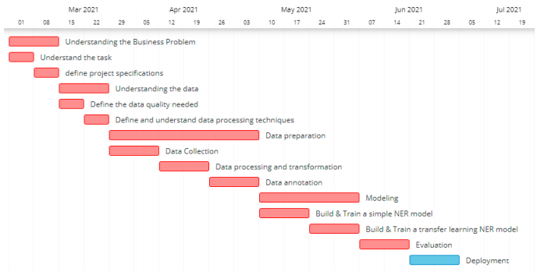
Project Tasks Planning
project Tasks Planning Time Table
Notes:
Here we present the project Tasks Planning Time Table through the 4 month internship , the working approach that we worked with is CRISP-DM that includes business understanding , data understanding ,Data preparation , Modeling , evaluation and deployment .
During the presentation we are going to present the work done in each step

Slide 9
2
Data Collection
Data Preprocessing
Data Annotation
Data Collection & Preparation
9

Slide 10
Data Collection
Data collection
NER Trained model
NER Model
Web scraping
script
Annotated Data
PDF-To-Image
Transformer
Images
OCR Processing
Text
Language detection
French Text
Annotation Tool
Active Learning Process
Data preparation
10
Notes:
Let’s start with the data collection modules which is the first step in the solution building workflow

Slide 11

Data Collection
What data do we need ?
Bylaws documents files
Moniteur Belge website
Written in French
At least 400 documents
How to get that data ?
Web scraping
script
Moniteur Belge website
Web Scraping Techniques
Notes:
In this part we are going to answer two main questions:
What data do we need ?
And how to get that data ?
Let’s start with the first one ,
in our solution we need bylaws document files the same ones that the employees are supposed to process manually ,
Our solution is built for french companies so we need document written in french
we estimate that having around 400 document is going to be enough in our case .
For the second question we choose Moniteur Belge website as a data source it’s the official journal publishing laws and regulatory texts of the belgian State .
And we used the web scraping techniques in order to extract the files from the website

Slide 12


Web Scraping
Moniteur Belge website
Based on publishing date
Based on company’s ID
700 PDF files
4900 PDF files
Total = 5 600 PDF files
Notes:
We used first scrapy library to extract documents from the Moniteur belge website based on thier publishing date
and we managed to scrape 700 PDF file ,
then we tried to selenium to scrape documents based on companies ID
Which enabled us to extract 4900 PDF file
and that gave us a total of 5600 pdf file .

Slide 13
Data Preprocessing
Data collection
NER Trained model
Moniteur Belge website
Web scraping
script
NER Model
Annotated Data
PDF-To-Image
Transformer
Images
OCR Processing
Text
Language detection
French Text
Annotation Tool
Active Learning Process
Data preprocessing
Data annotation
Notes:
The next step is the data preparation

Slide 14

Data Preparation Process
Dutch Texts
Images
Texts
PDF-To-Image
Transformation
OCR Processing
(Tesseract)
Language detection
French Texts
Optical Character Recognition (OCR):
  consist of determining handwritten and printed text characters in a digital image of physical documents
Tesseract : An OCR tool based on Deep Learning
14
Notes:
the mission is that we have to extract french texts just starting from the pdf files that we collected
First the module takes the pdfs and transforms them into images to be able then to perform the Optical character recognition process using tesseract.
Optical Character Recognition (OCR): It’s an AI technique that consist of determining handwritten and printed text characters in a digital image of physical documents
Tesseract is an OCR tool based on deep learning techniques that provides a good image to text transformation result.
The collected documents are mixed there are french files and dutch files so we have to filter them.
just after transforming them into text we placed a language detector that keeps only french texts and leaves the dutch ones in storage in case of the company needs them in another project.

Slide 15
Data Annotation
Data collection
NER Trained model
Moniteur Belge website
Web scraping
script
NER Model
Annotated Data
PDF-To-Image
Transformer
Images
OCR Processing
Text
Language detection
French Text
Annotation Tool
Active Learning Process
Data preprocessing
Data annotation

Slide 16

Data Annotation
Company Name
What entities do we need to extract?
Legal Representative First Name
Legal Representative Last Name
Function
Valid From
Valid To
In The Name Of
How to annotate the data ?
Accelerate the annotation
Active Learning Technique
Require a weak supervision
Doccano Annotation Tool
Notes:
Data annotation is a very important step in project because the annotation approach and the labels have a major impact on the model’s performance
In this part we are going to answer two main questions :
The first one what entities do we need to extract
The second one is how to annotate the data
For the first question we choose labels that employee usually wants to extract from a document :
the company names the legal representative's first and last name and their function,
in addition to valid from and valid to which refers to the start and the end of the information validity.
And since some companies allow one of their members to act on behalf we also added the label « In the name of »
to answer the second question, we choose the active learning annotation approach because it accelerates the annotation process and requires weak supervision.
For the annotation tool, we choose Doccano because it supports entities labeling, the import, and the export of the data which we need to perform the annotation

Slide 17
Active Learning annotation process
Collect a small training set
Pool- Based approach
Train a simple model
Uncertainty sampling quering strategy
We select the Least Confident
samples each time
Gather a large set of unlabeled data
Do we Need more training data?
No
Yes
Make prediction on unlabled set
Terminate
Iterations | Input training documents | Predicted documents with the lowest certainty score | Corrected documents
1 | 100 | 250 | 100
2 | 200 | 50 | 37
3 | 237 | 184 | 138
4 | 375
total |  | 375
Correct and Label the most uncertain example
Add corrected labeled example to the training set
Retrain the model
Notes:
In our active learning annotation process, we choose to work with
A pool-based approach with an uncertainty sampling querying strategy,
and we selected the least confident samples each time.
To explain more :
The cycle starts with creating a small training set that we labeled manually,
in our case we started with 100 documents, use them to train a simple model then we took a large set of the unlabeled data
and in each iteration, we ask the question whether we need more training data or not?
if we don’t the process stops
else we make predictions on the unlabeled set, correct the samples with the lowest confidence score then add them to the training samples, retrain the model, and so on.
In the first iteration, we selected the 250th least confident documents corrected 100 of them
added them to the training set, and retrain the model.
And so on to get finally in the 4th one a total of training data 375 document

Slide 18
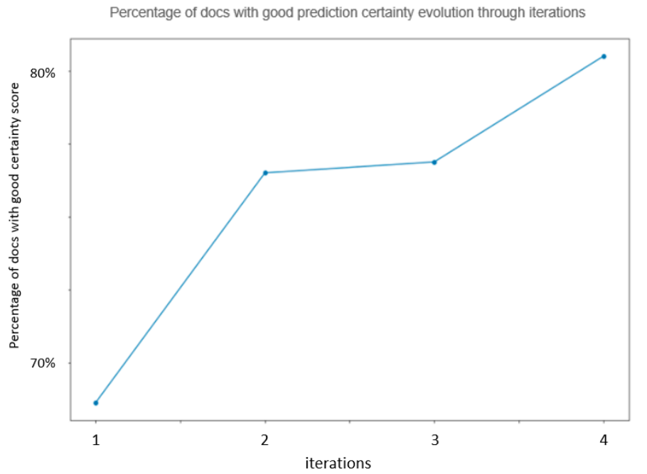
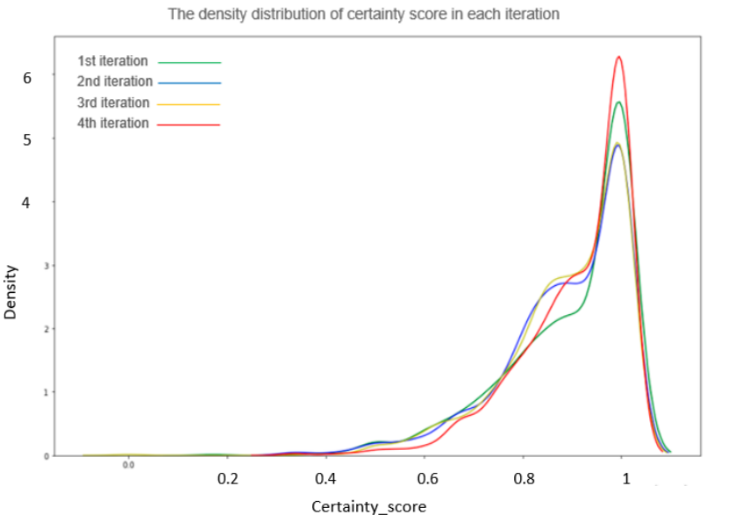
Annotation process performance through iterations
sThe density distribution of the certainty score in each iteration
Percentage of docs with a good certainty score through iterations
Certainty Score
iterations
Label | Company Name | Legal Representative First Name | Legal Representative Last Name | Function | Valid From | Valid To | In Name Of | Total
Entity Counts | 454 | 1560 | 1576 | 1122 | 296 | 358 | 138 | 5504
Notes:
To track the performance in each iteration, we used those two plots:
As can be seen in the Figure in the right, the density distribution of the certainty score in each iteration
the red line curve, representing the fourth iteration,
which has the highest density in the area where the certainty score is greater than 0.8 compared to other curves
which represent the earlier iterations
This prouves that the prediction accuracy is improving through active learning iterations.
In the figure on the left represents the iteration’s performance improvements. It shows the proportion of documents with a successful prediction in each iteration.
As we can see, we progressed from 68% of documents with good prediction in the first iteration to more than 80% of documents with a good certainty score in the fourth iteration.
The data labeling result is presented in a table that shows per each label the count the annotated entities
we labled in total 5504 entity

Slide 19
3
Building a NER Model
19
Notes:
Moving to the modeling step

Slide 20
Building a NER Model
Data collection
NER fine-tuned Model
Moniteur Belge website
NER Pre-Trained Model
Web scraping
script
Annotated Data
PDF-To-Image
Transformer
Images
OCR Processing
Text
Language detection
French Text
Annotation Tool
Active Learning Process
Data preparation
Data annotation
Notes:
The modeling step is the last task in the solution building workflow and it consist of leveraging transfer learning to get a NER model with a good performance.

Slide 21

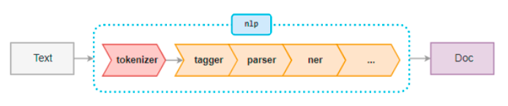
SpaCy French NER Blank Model
Customized
Natural Language Processing Model pipeline based on
Convolutional Neural Network (CNN)
Metric | Score
Precision | 68.29
Recall | 63.2
F Score | 65.65
Notes:
Before jumping to the transfer learning technique we did an experiment as a reference using the same model with which we performed the active learning process.
The model was a simple one, created with spacy NLP pipeline mainly with NER component which enabled us to perform the customized NER
And It is based on convolutional neural network
We used 70% of the labeled data for the training and the rest for the testing
The model evaluation is displayed in this table
It gave us a prediction with 68% precision , 63% Recall and 65% F score which means that it wasn’t able to recognize a significant percentage of the existing entities and the assigned labels are in most cases was correct but not good enough

Slide 22
Transfer Learning for NLP
Less training data needed
Transfer Learning
  is a machine learning method where a model developed for a task is reused as the starting point for a model on a second task
Less processing time
Fine-Tuning a Pre-Trained Model
Pretrained
model
Task specific Layers (NER)
Text input
entities
22
Notes:
Transfer Learning: is a machine learning method where a model developed for a task is reused as the starting point for a model on a second task.
which give the possiblity to build advanced models that learn from just few amount of data.
The transfer learning modeling approach that we are going to use is fine-tuning
it consist of taking a pretrained model and we add an additional layer on the top of the existing one which is the task specific layer.
NER in our case

Slide 23

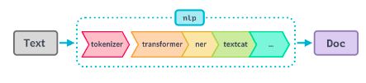


CamemBERT Model
BERT : Bidirectional Encoder Representations from Transformers
CamemBERT
is for the French Language pretrained on the French sub corpus multilingual OSCAR
camembert-base
Metric | Score
Precision | 75.93
Recall | 82.14
F Score | 78.91
Notes:
The pre-trained Model that we used is CamemBERT
BERT stands for Bidirectional Encoder Representations from Transformers
and
CamemBERT is a cutting-edge French language model trained on the French subcorpus of the recently released multilingual corpus OSCAR.
To fine-tune the pre-trained model we used again the SpaCy library because it provides interaction with PyTorch and the HuggingFace transformers library which give access to thousands of pre-trained pipeline models.
So we added "camembert-base“ transformer to the SpaCy NLP pipeline and finetuned the model
it gave us a 75.93% precision, 82.14% Recall and F score of 78.91 % which reveals a good named entities prediction, the model was able to detect most of the existing entities and identify their labels correctly. And this prouves that transfer learning make it possible to build a model with better performance that the traditional approach .

Slide 24
4
End-to-end Solution
24

Slide 25
End-to-end Solution Workflow
New PDF file
Images
Text
French Text
CamemBERT fine-tuned Model
PDF-To-Image
Transformer
Tesseract
Language detector
Data preparation
Company Name
Legal Representative first Name
Legal Representative last Name
Function
Valid To
………
Notes:
In the final end-to-end solution workflow
we begin with a new PDF file and proceed through the same phases as the building data preparation process: ( PDF to image transformation, OCR processing, and language detection and filtering to extract the French text from the pdf). The extracted text is going to be consumed by the NER fine-tuned model to get the retrieved entities: company name , legal representative first and last name, etc

Slide 26
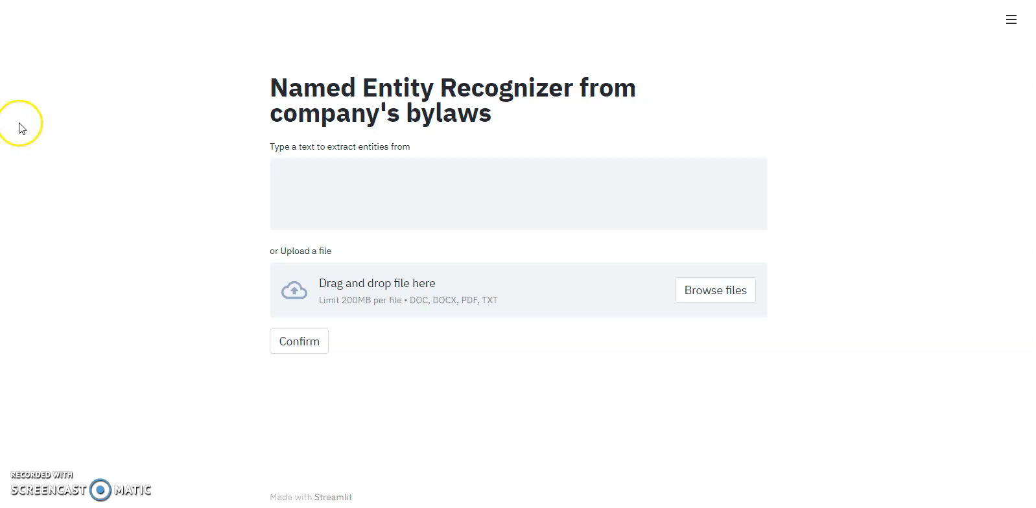

Graphical user Interface

Slide 27
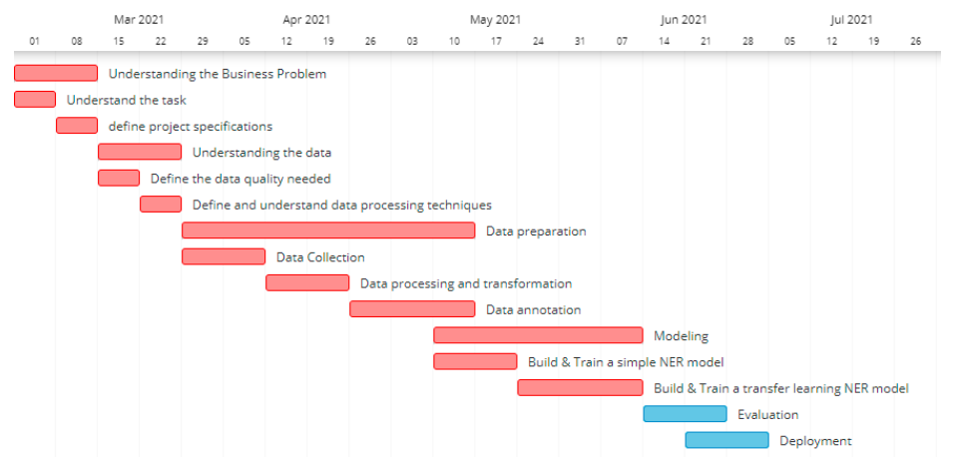
Project Tasks Realisation
project Tasks realisation Time Table
Notes:
Here we present the project tasks realisation time table as can be seen some tasks to much time than what we estimated like data preparation task and this because the additional document preprossing step that we added in order to get good a good data quality
We notice also that the modeling and the data preparation task overlap and this mainly because we required some modeling in the active learning annotation process .

Slide 28
5
Conclusion & perspectives
28

Slide 29
Conclusion & perspectives
What did we achieve ?
Creating labeled data from scratch
Building an NER model with 78.91% F score
Developing an information extraction end-to-end solution
How can we improve the project in the future?
Add new labels : company ID , Document topic etc
Annotate more data using different annotation approaches like rule-based approach in combination with active learning
Add relation extraction component between entities
Notes:
In the conclusion, we can say that we were able to fulfill most of the project specifications by
Creating a labeled data from scratch
Building an NER model with 78.91% F score.
Developing an end-to-end solution that enables employees to extract information from bylaws documents.
Yet there is a lot of improvement and features that can be added in the future like adding new labels, provide more annotated data and also add a relation extraction component.

Slide 30
Thank you for your attention
30

Slide 31
Those slides can be used to answer some questions

Slide 32
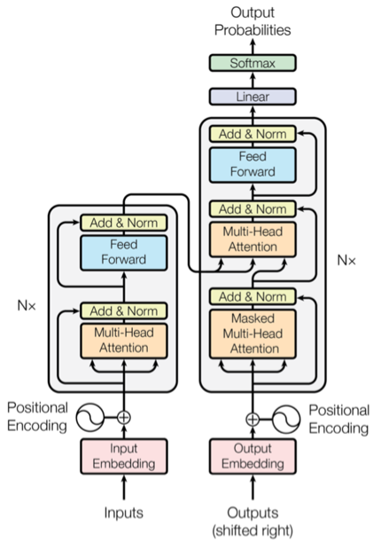
Transformers
Generate next word prediction
The embeddings are vectors that encapsulate the meaning of the word
embeddings
decoder
Simultaneous process of each word and generate embeddings
encoder
Text words
Privously generated prediction
Notes:
This is the transformer neural network architecture that was initially created to address the issue of :
Bidirectionality and the slow training of LSTM
Transformers are faster because the words are processed simultaneously
and the context is better learned as they can lean context in both directions similtanously
The decoder take the embeddings from the encoder and the previously generated prediction
There is a task sepecation between the encoder and decoder :
The encoder learns : the context
The decoder learn : how the prediction and the existing text are related
The encoder takes the input text and transforms each word into embeddings simultaneously. Those embeddings are vectors that encapsulate the meaning of the word.
The decoder takes these embeddings from the encoder and the previously generated words (output shifted right) and then uses them to generate the output.

Slide 33
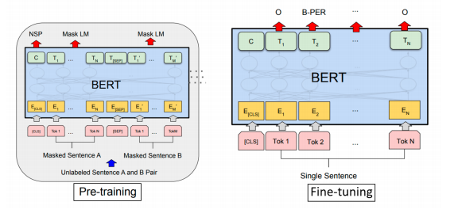
BERT
Label for each token eg PER: person
Binary output for the next sentence prediction
Word vector include the output of MLM
token
Word embeddings
The [MASK1] brown fox [MASK2]
task 1: Masked Language Model (MLM)
task 2: Next Sentence Prediction (NSP)
Simulta-nously
understand the bidirectional context within a senetence
Sentence A
Sentence B
Notes:
Bert is created by stacking a set of encoders of the transformer architecture and lin them with one decoder
The pre training is for making the model understand the language and context
The fine-tuning is for teaching the model to perform a specific task
The pretraining is done with two unsupervised task simultaneously
MLM : bert take a sentence with random words filled with mask , the goal is to output these mask tokens this helps understand the bidirectional context within a senetence
We add a soft max activation fully connected layer to convert a word vector to a distripution and the label will be in a one hot encoded vector
During the training we try to minimize the Cross Entropy Loss
For the fine tuning it consist of replacing the fully output collected layer of the network with a fresh set of the network of output layer that can perform the NER task . It’s not going to take so much time because only the output parameter are going be learned from scratch . And the rest of the model parameter are going to slightly fine-tuned
Fine tuning is performed through modifying the input and the output layer
in pre-training, the input is a set of two sentences with some of the words being masked and each token is a word as shown in the ﬁgure T ok1 .. T okN and we convert each of these words into embeddings Ei using pre-trained embeddings provides a good starting point for BERT to work on.
On the output side, C is the binary output for the next sentence prediction so it would output 1 if sentence B follows a sentence A in context and 0 if sentence B doesn’t follow sentence A.
Each of the Ti is a word vector that corresponds to the outputs for the Masked model language task. So the number of word vectors that we input is the same as the word vectors that we output.
In the ﬁne-tuning phase, if we want to perform NER task, we would train the model by modifying the input and the output layer. We pass the sentence each word in a token as input. And the output layer we would put the tokens with their labels ( B-PER as shown in the ﬁnetuning ﬁgure)

Slide 34
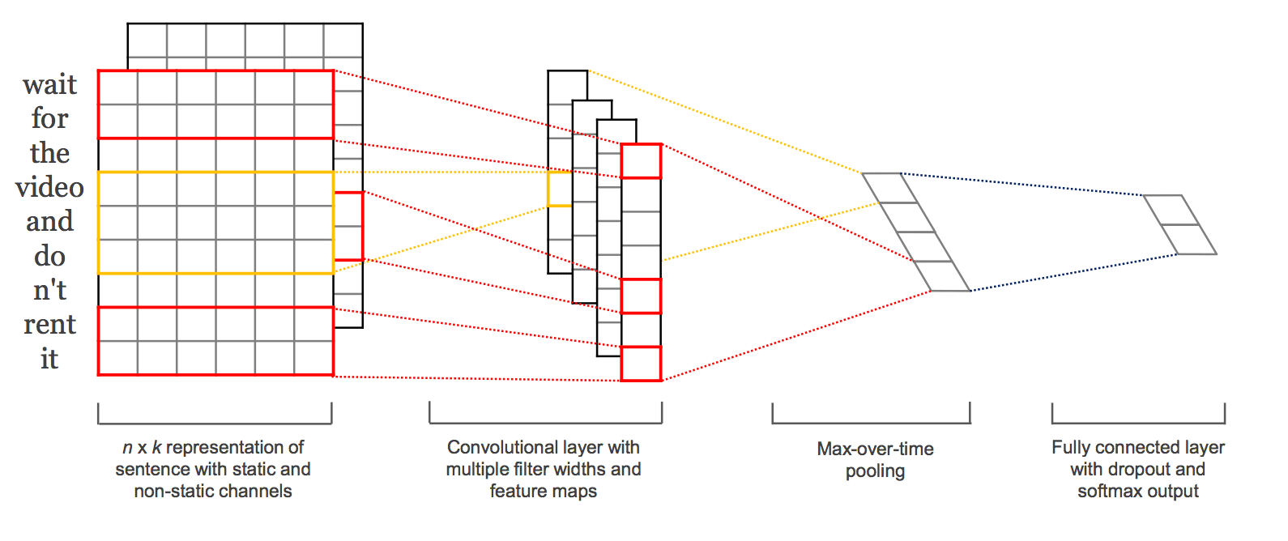
CNN for NLP
spacy.HashEmbedCNN.v2

Slide 35

Data collection details

Slide 36



Metrics
Notes:
Precision : The question that this metric answer is of all reviews that were labeled as positive, how many actually are positive?
It avoids making mistakes
Recall: The question recall answer is: of all reviews that are truly positive, how many did we label?
With precision you is how sure you are that a positive prediction is actually positive
And with recall you make sure that you are not missing out a positive observation
F Score is the harmonic mean between precision and recall

Slide 37
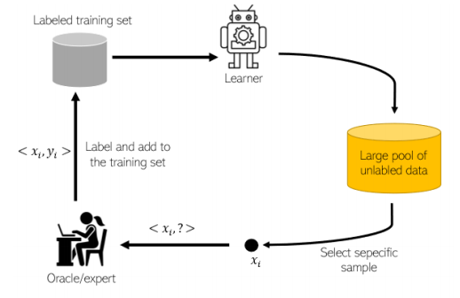

Active Learning
Easier to implement
Pool based approach
Doccano does not support files streaming
Uncertainty sampling strategy
Least confident
Provides least computation complexity

Slide 38
Beam certainty score
0.1 Company Name
0.03 Leagal representattive First Name
0.07 Leagal representattive Last Name
0.75 Function
0.05 Valid from
0.05 Valit To
0 in the name of
Entity
label
Function with 0.75 certainty
A document contains so many entities
A document certainty score is the average of all the entities certaint score

